Slide 1
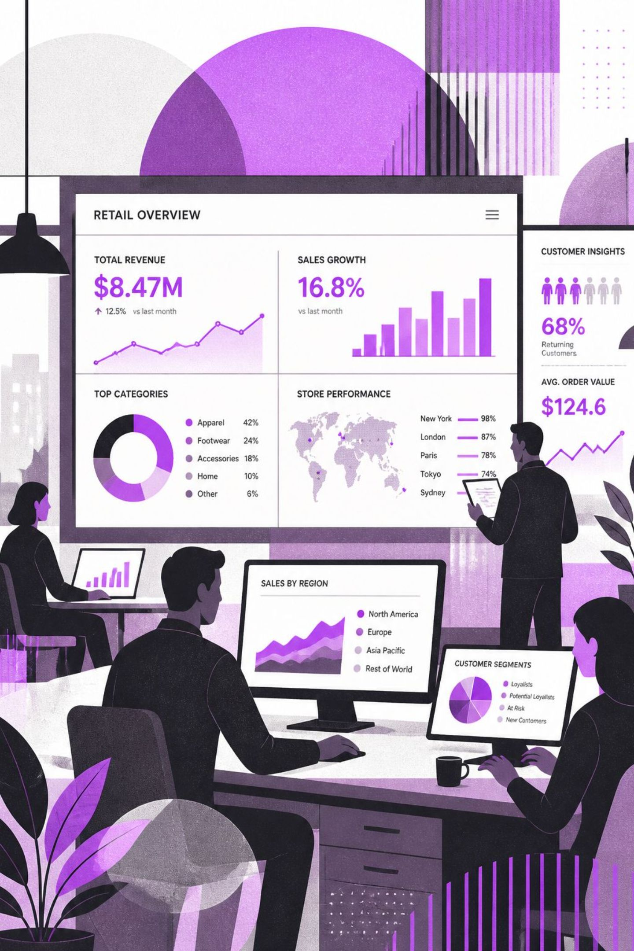

Customer Shopping Behavior Analysis
An End-to-End Data Analytics Project Using Python, SQL and Power BI

Slide 2



The Challenge
Data Without Direction
Retail businesses generate large transaction volumes but lack infrastructure to convert raw records into actionable intelligence.
Blind Spots in Strategy
Without clear insight into customer demographics, purchase patterns, and preferences, businesses cannot effectively target marketing or optimize product mix.

Slide 3
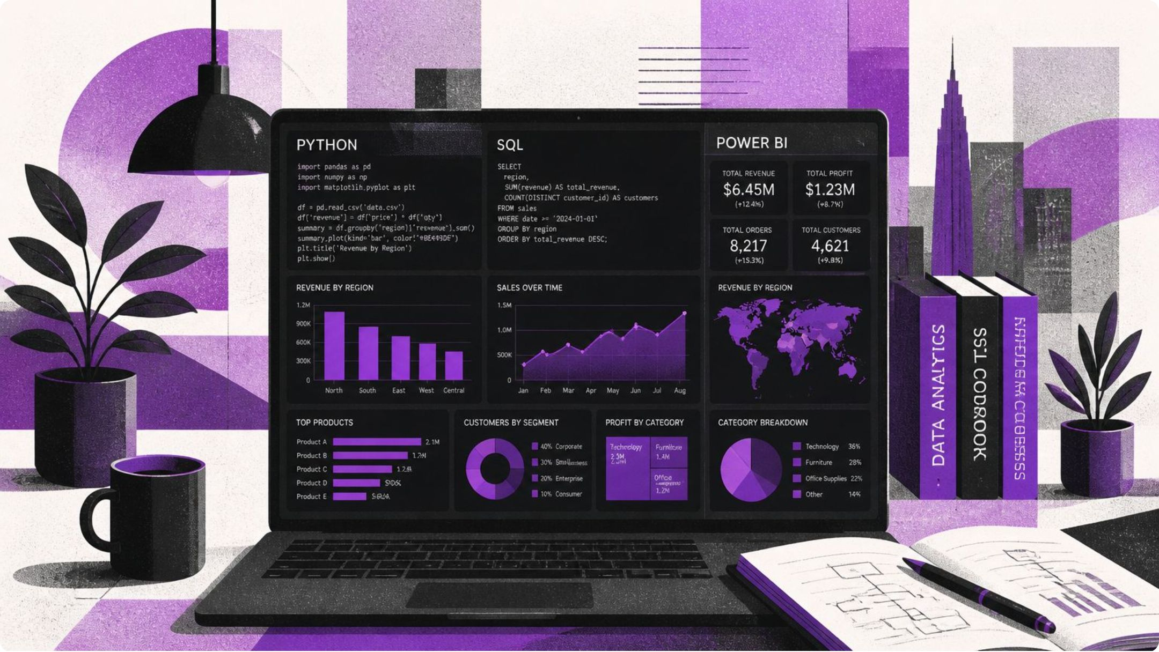
Project Scope
Dataset
3,900 customer transactions across 18 columns
Tools
Python (Pandas), MySQL, Power BI
Objectives
Clean data, execute 10 SQL analyses, build interactive dashboard

Slide 4
Data Cleaning & Preparation
01
02
Impute Missing Values
Feature Engineering
Imputed 37 missing Review Rating values using category-level median to preserve data integrity.
Engineered age_group feature via quartile segmentation: Young Adult, Adult, Middle-aged, Senior.
03
04
Remove Redundancy
Export to MySQL
Discovered and removed redundant column: Discount Applied = Promo Code Used (100% identical).
Exported cleaned 3,900 × 19 dataset to MySQL for structured SQL analysis.

Slide 5

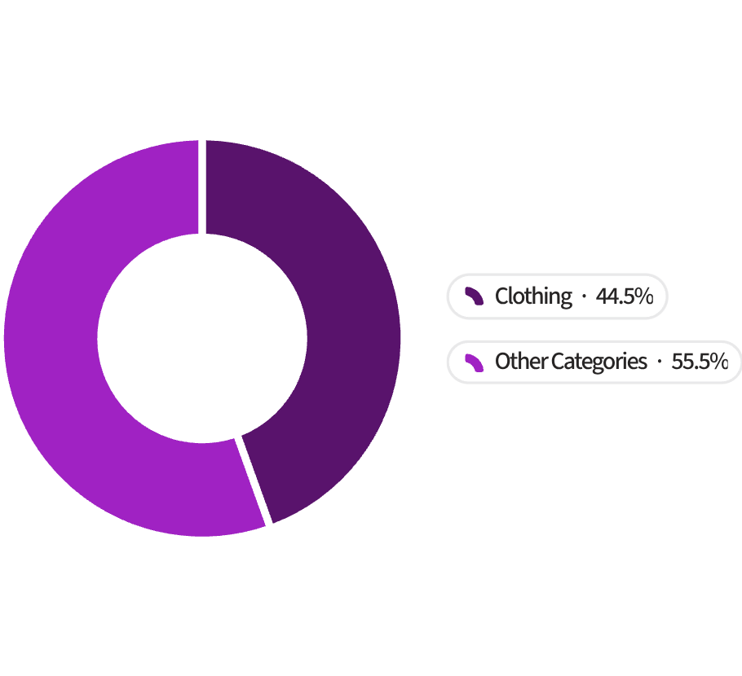

Key Finding: Clothing Dominates
Revenue Breakdown
Clothing generates ~$104K revenue — representing 44.5% of all transactions.
1,737 clothing records vs. 250 outerwear records — a 7× volume advantage over the next closest category.
Implication: Protect inventory and prioritize marketing in this category.

Slide 6

Key Finding: Young Adults Lead Revenue
$62K
1,028
11%
Young Adult Revenue
Transactions
Revenue Edge
Ages 18–30 generate the highest revenue of all age groups
Young Adults account for the most purchase records in the dataset
More revenue than the Adult segment — the next closest age group
Implication: Digital and social media targeting should focus on the 18–30 demographic.

Slide 7
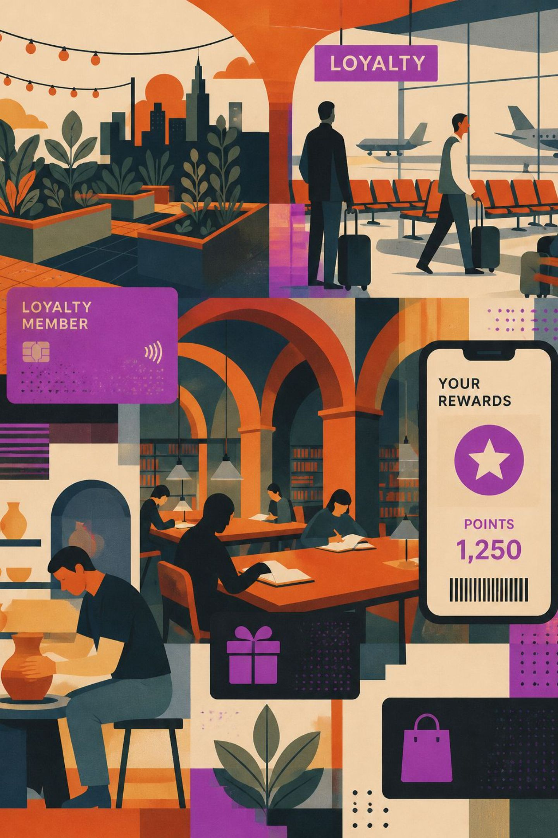
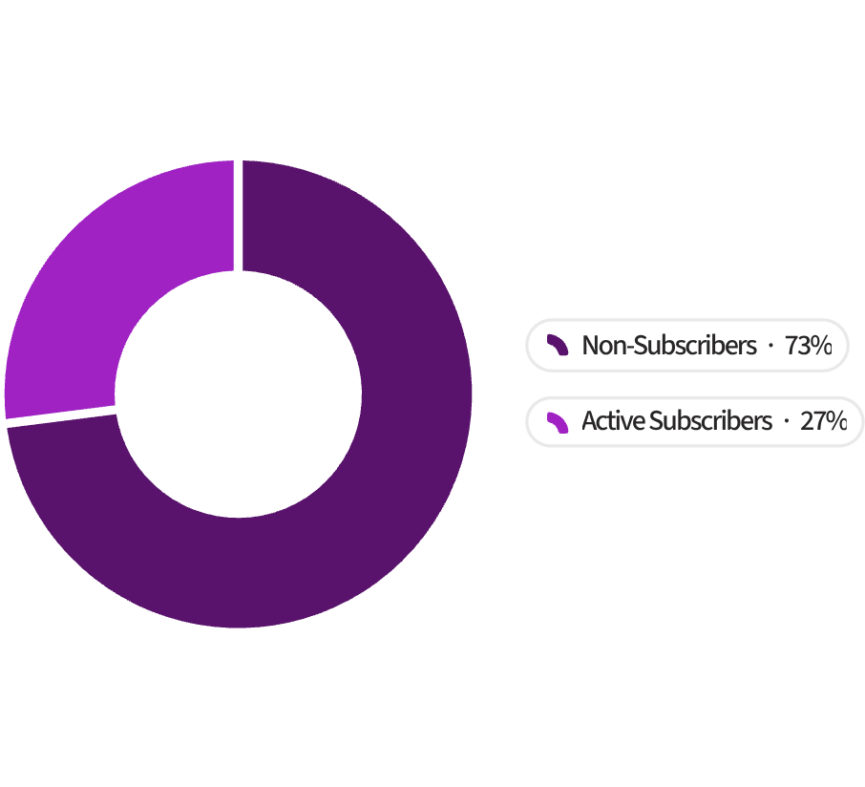
Key Finding: Subscription Opportunity
A Largely Untapped Base
73% of customers are non-subscribers — 2,847 out of 3,900 total customers.
Only 27% hold active subscriptions (1,053 customers), leaving a significant recurring-revenue gap.
Converting just 10% of non-subscribers adds approximately 285 recurring-revenue customers to the base.

Slide 8
Key Finding: Discounts Don't Drive Spend
What the Data Shows
Strategic Implication
High-value discount users spend at or above the $59.76 average — discounts are not the driver of higher spend.
Shipping type has no material effect on purchase amount across all 6 shipping types tested.
Replace blanket discounts with loyalty rewards that reinforce repeat behavior without eroding margin.
Position shipping upgrades as perks, not upsells — customers are indifferent to shipping type when making purchase decisions.

Slide 9



Dashboard Overview
KPI Cards
Visual Panels
Interactive Slicers
3.9K customers · $59.76 avg purchase · 3.75 avg rating — top-line metrics at a glance.
Subscription donut, revenue & sales by category, revenue & sales by age group — all in one view.
Dynamic filters for subscription status, gender, category, and shipping type enable drill-down exploration.

Slide 10
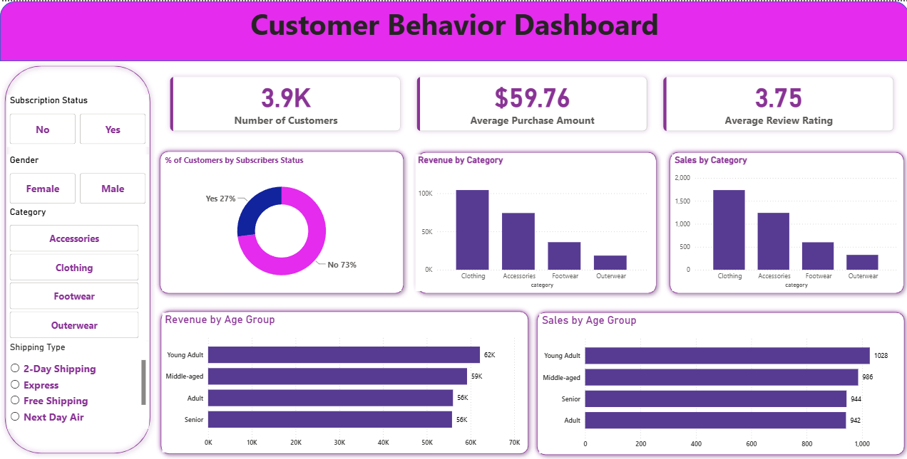
Dashboard Screenshot
Interactive Power BI dashboard delivering KPI cards, category revenue breakdowns, age group analysis, and subscription segmentation — all filterable by gender, category, and shipping type.

Slide 11

SQL Analysis Highlights
1
2
3
Q1 — Revenue by Gender
Q3 — Top Products by Rating
Q7 — Loyalty Segmentation via CTE
Male customers (68%) generate proportionally higher total revenue — informing gender-targeted campaign allocation.
Top 5 products by review rating identified as prime candidates for featured placement and promotional spotlight.
Customer loyalty segmentation using a Common Table Expression reveals the majority fall into the 'Loyal' category (>10 purchases).

